Slide 1
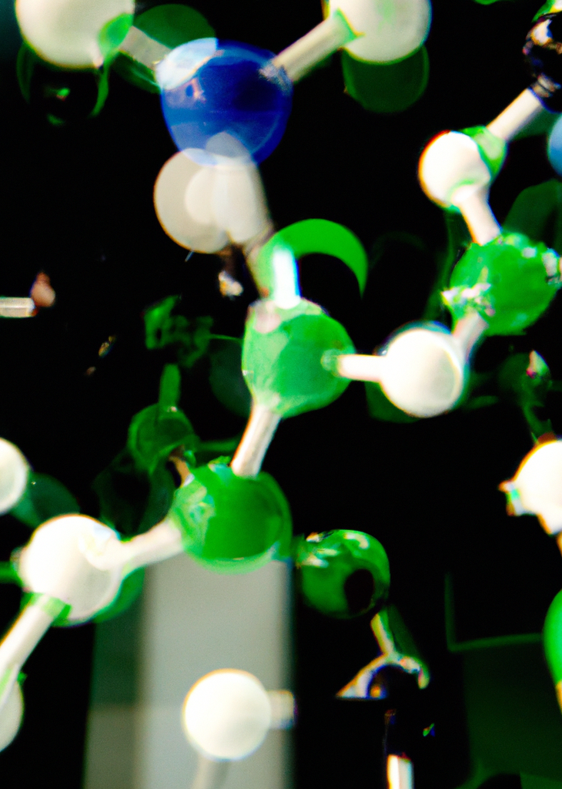
CH-315 Modeling Lab

Slide 2
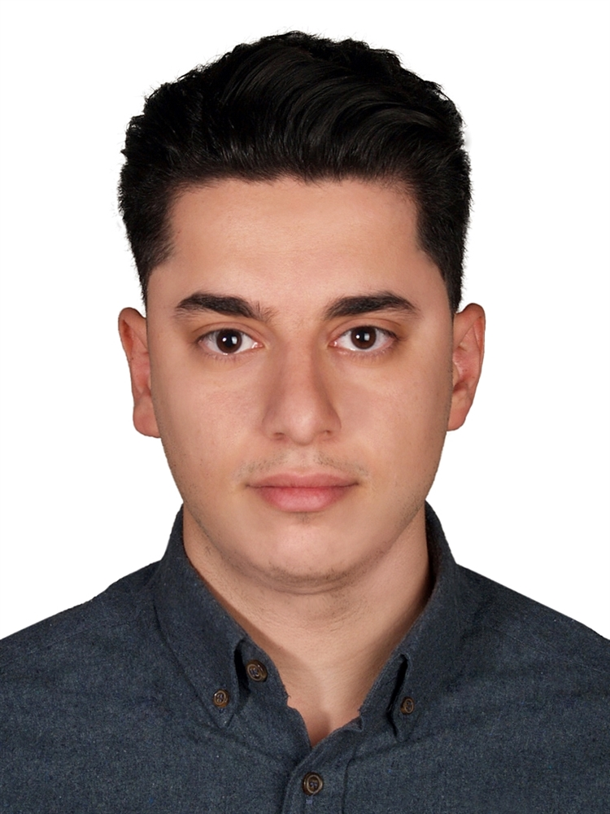
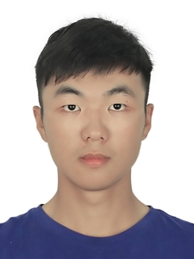

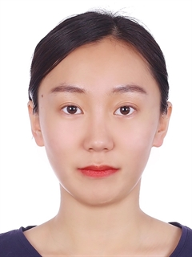

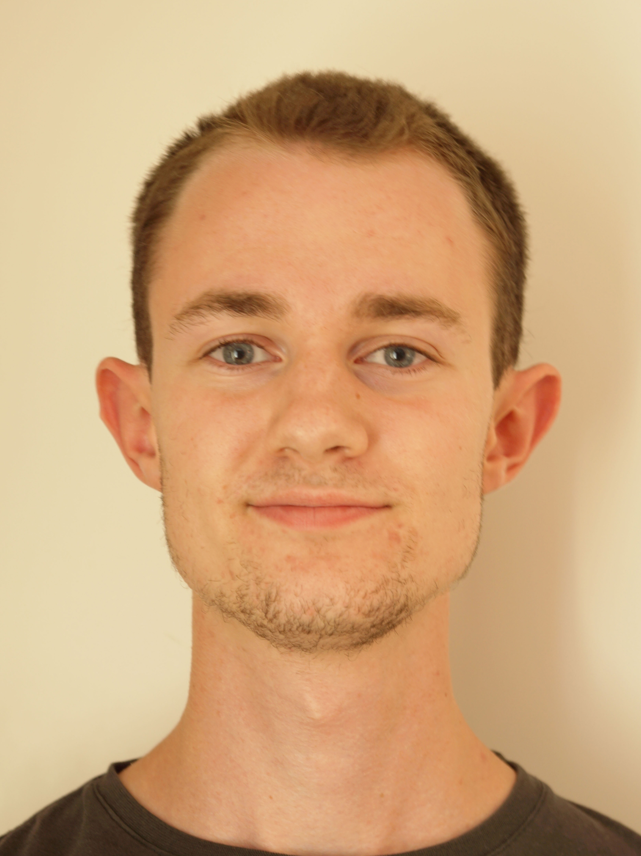
TA Team
Amir Elahi
Coordinator
Yutao Li
Xin Jin
Xiaoqi Zhang
Chadi Assaf
Theo Stölzl

Slide 3
TA Team
If you have any question regarding the organization of the course, grades, submissions, deadlines, groups …
Email to amir.elahi@epfl.ch or ask in class
Please keep in mind that we are not a hotline! If you have a question related to the material, you either:
Ask in class
Email Amir and he will put you in contact with the corresponding TA.

Slide 4
Course Organization
The course will be divided into three blocks
Block 1: Computational Carpentry
Block 2: Molecular Simulations on Adsorption
Block 3: Machine Learning in Chemistry and Chemical Engineering
Deliverables
Block 1: Project
Block 2: Assignment(1), Assignment(2), Project
Block 3: Assignment, Project
Each Group is required to submit only 1 report with all members name in the report
You will work in groups of 3/2
1 Member only is responsible for submissions!
All submissions are due on time! On Moodle!
Deadlines will be told at least one week ahead

Slide 5
Grading

